Slide 1
Unit 26 Task 1
Theory in Action

Slide 2

Laura Mulvey (Male Gaze theory)
This is the heterosexual males point of view as he looks at a woman as an object who is there for the males pleasure. It suggests that the camera represents a male perspective so they are the subject and the woman they appear to be looking at is the object. The image of the woman takes the passive form and the gaze of man is the active form.
Quote: “In a world ordered by sexual imbalance, pleasure in looking has been split between active/male and passive/female. The determining male gaze projects its phantasy on to the female form which is styled accordingly. In their traditional exhibitionist role women are simultaneously looked at and displayed, with their appearance coded for strong visual and erotic impact so that they can be said to connote to-be-looked-at-ness.”

Slide 3
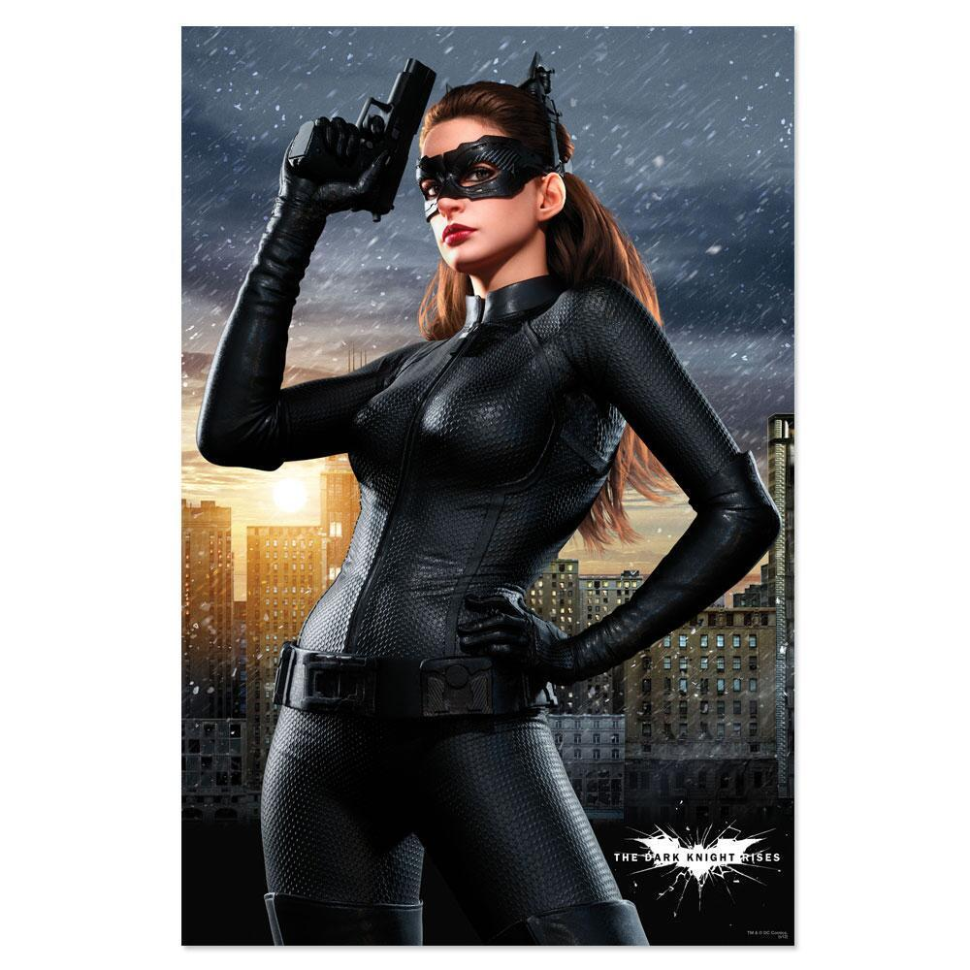
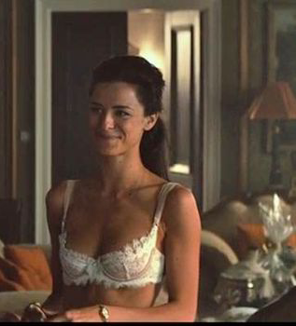
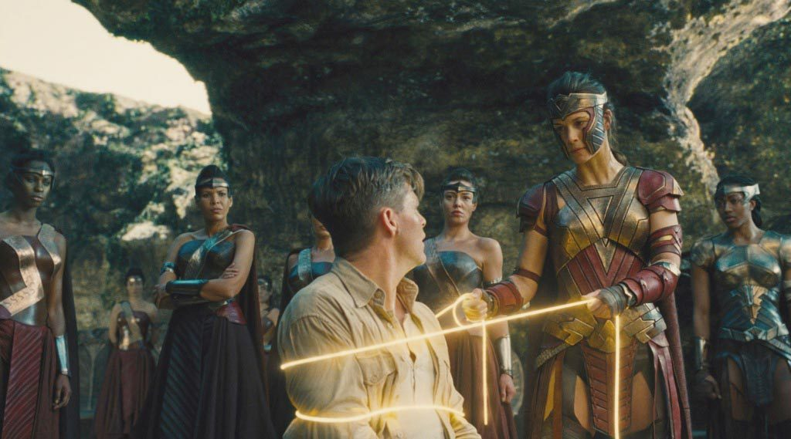
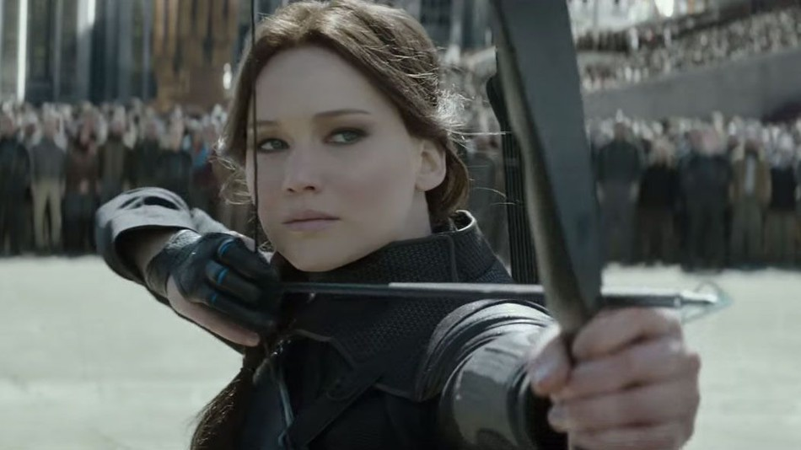

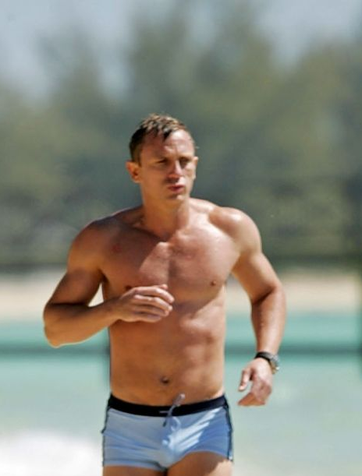
Laura Mulvey (Male Gaze theory) continued ...
30.8% of speaking characters are women
28.8% of women wear sexually revealing clothing
7.0% of men do
26.2% of women actors remove almost all their clothes
Although 9.4% of men do
10.7% of films had half of the characters are female

Slide 4
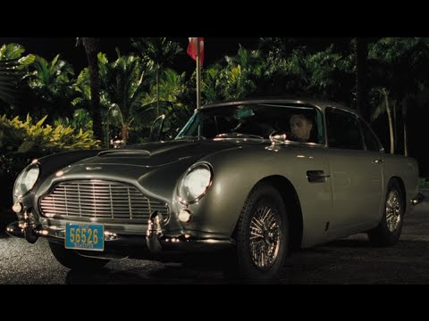
Laura Mulvey (Male Gaze theory) continued ...
In the James Bond film, ‘Casino Royale’ (2006) Thriller/Action genre, when the female character enters the room in an eye catching shiny red dress, the camera follows the male gaze on her as she walks towards the poker table. When she stops to greet her husband the camera does not focus on her face, instead it frames her husbands face and her chest as though that is what James Bond is looking at.

Slide 5
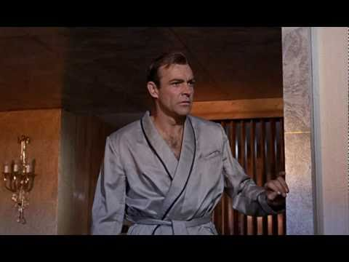
Laura Mulvey (Male Gaze theory) continued ...
Goldfinger (1964) Thriller/Action genre
Sean Connery’s James Bond film strongly follows the theory. This is because of the risky camera angles and the fetishistic scopophilia that builds up the physical beauty of the woman, Jill, on the bed. For example, in this scene, Jil is seen on the bed covered in golden paint from head to toe and the couch pillow is cleverly placed to cover her posterior, however, her beauty is still more than evident.

Slide 6
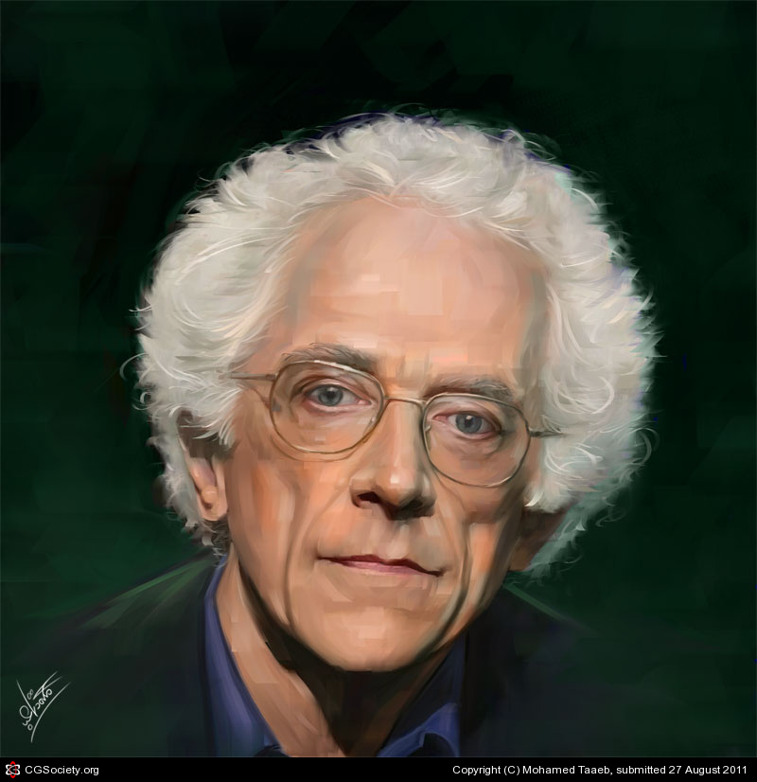
Todorov’s Narrative Theory
Equilibrium
Disruption
Equilibrium / narrative structure:
Vladimir Todorov came up with the theory with five main points; the beginning where everything is normal, something happens, the protagonist finds a way to fix the disruption, everything starts to get fixed and finally the return to equilibrium but not everything is the same.
Resolution
Restored Order
New Equilibrium

Slide 7
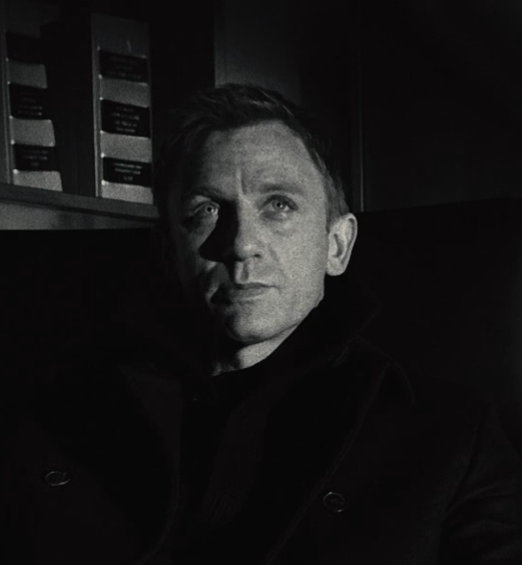

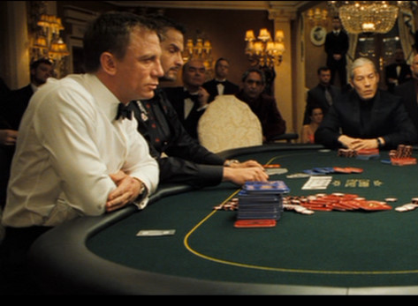

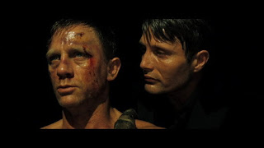
Todorov’s Narrative Theory
Tzvetan Todorov’s five points to show a narrative structure. The points are as follows for Casino Royale (date)
Equilibrium- The beginning, everything is normal
Disruption- Something happens
Resolution- The protagonists find a way to fix the disruption
New Equilibrium- Return to the equilibrium but not everything is the same
Resorted Order- Everything starts to get fixed

Slide 8
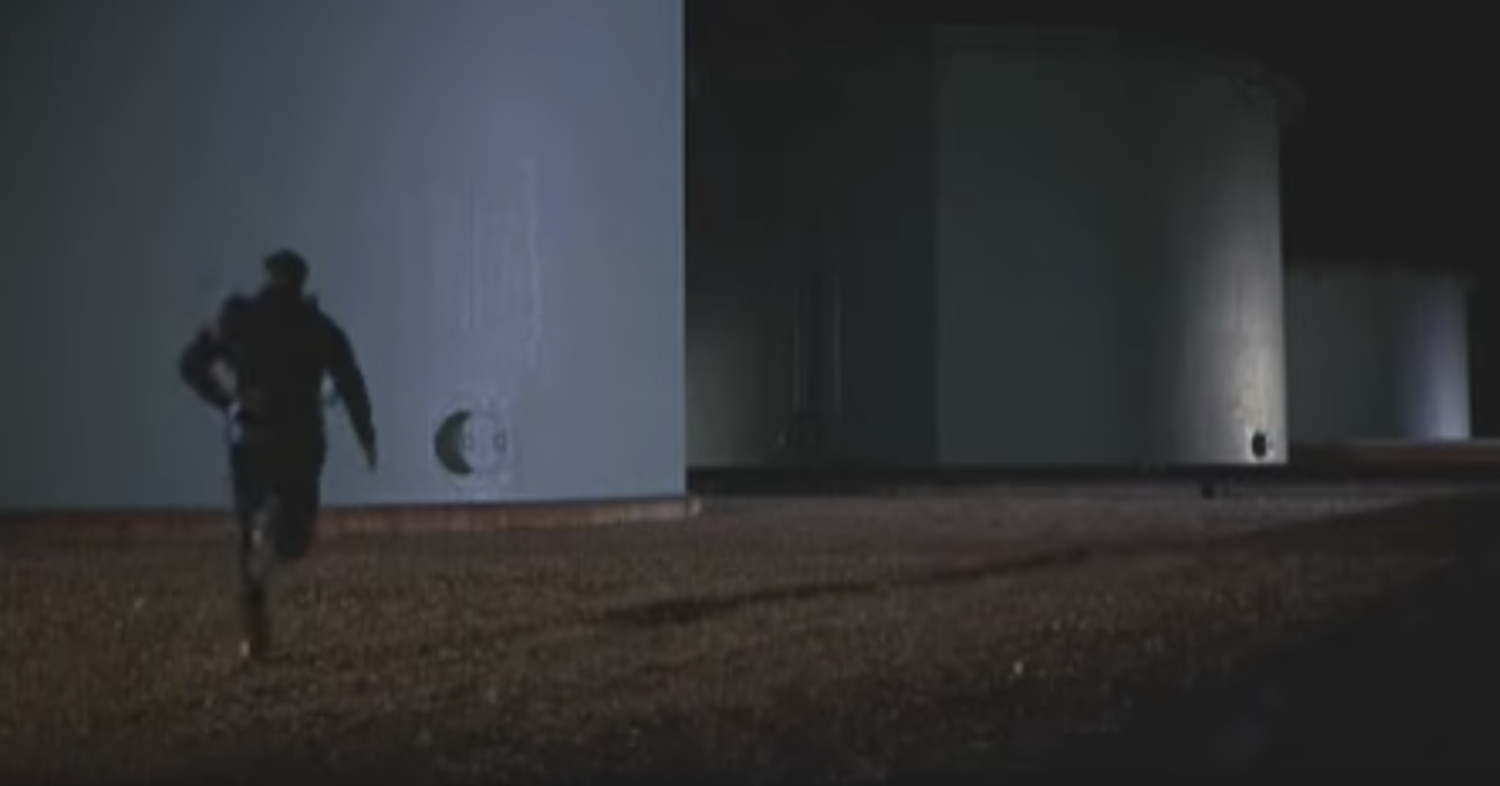
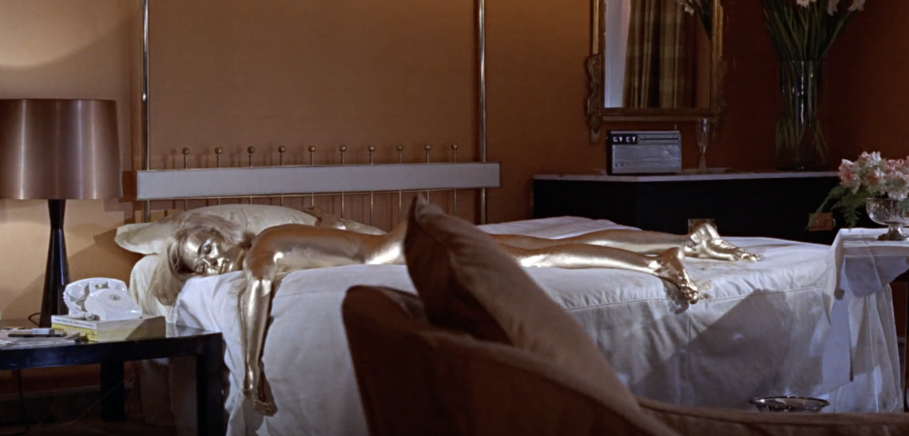
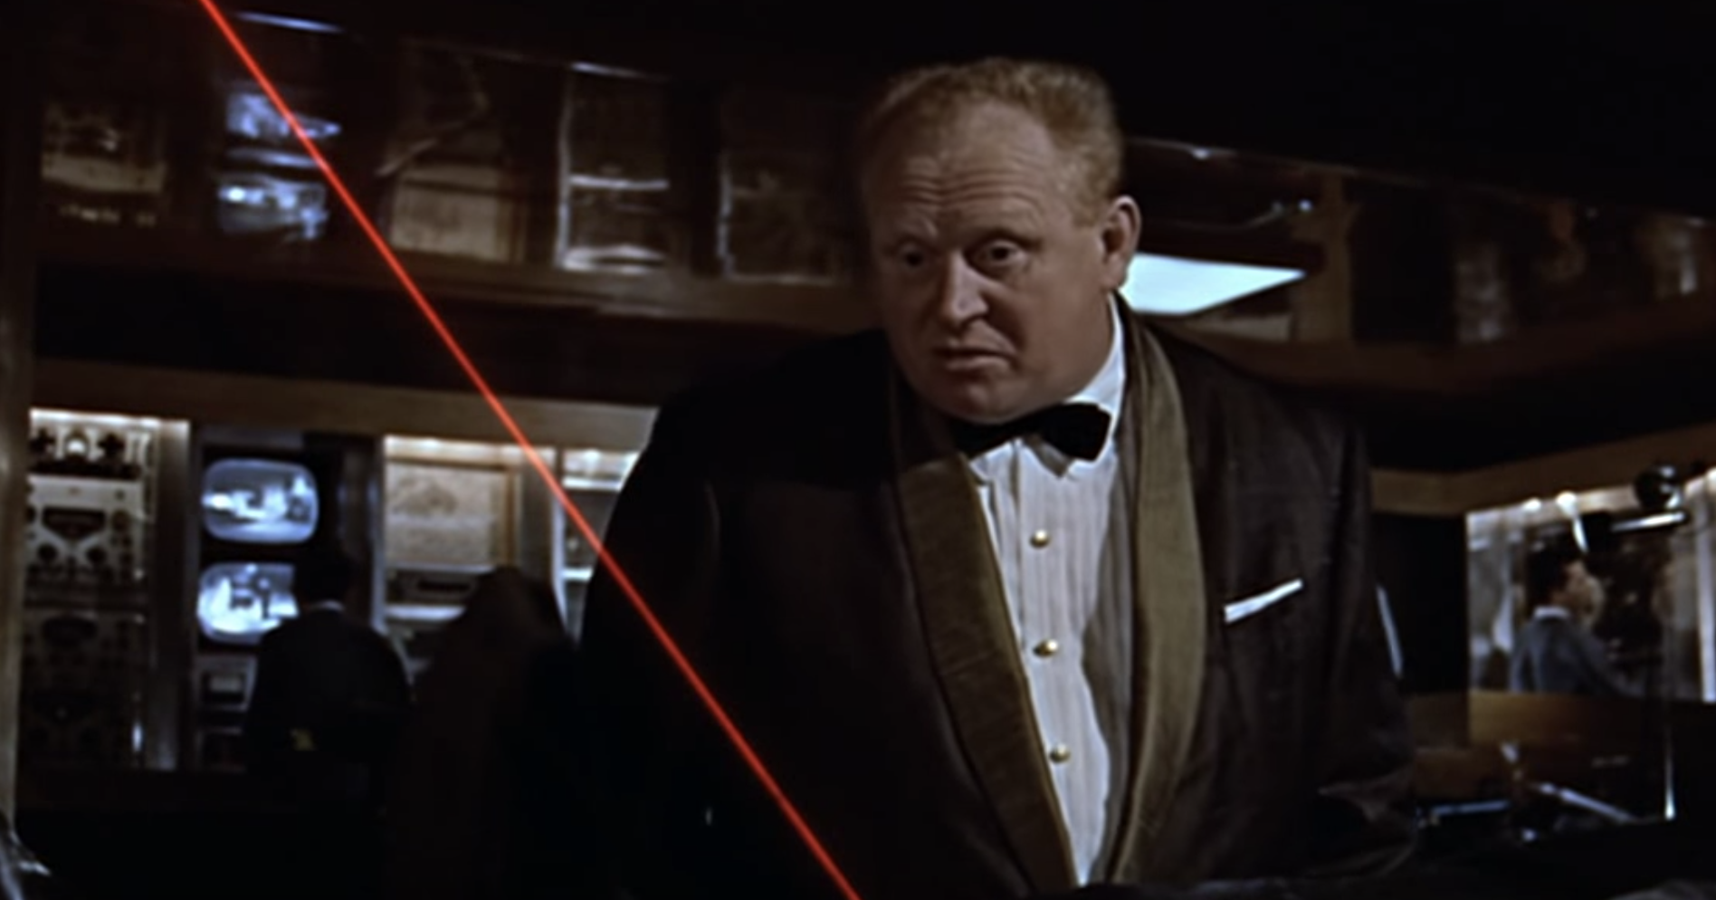
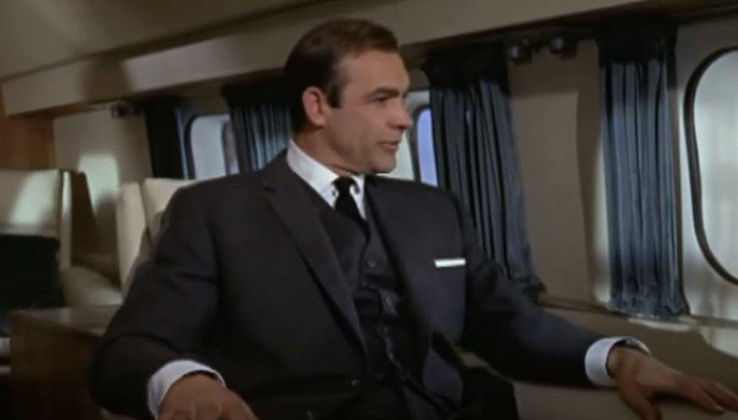
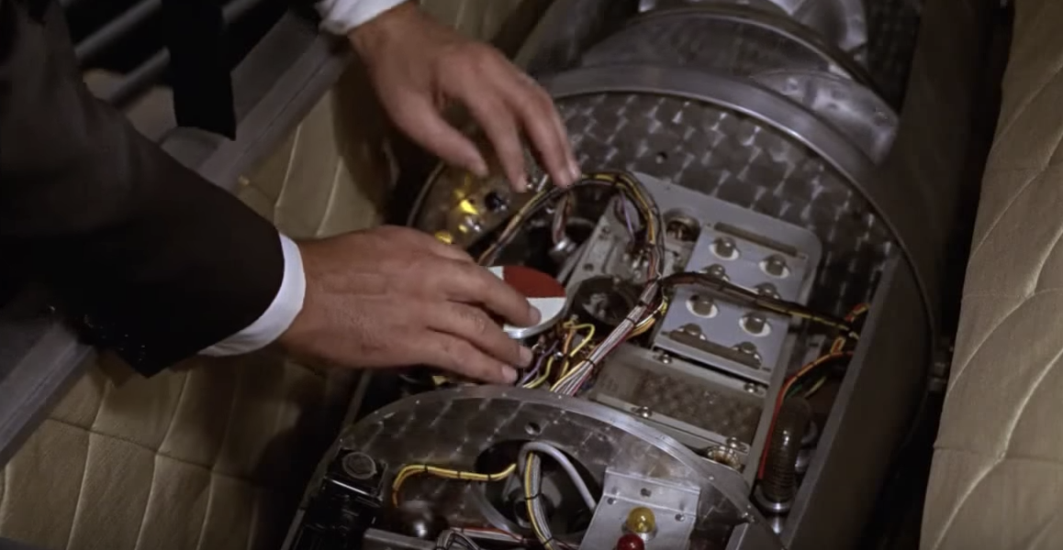
Todorov’s Narrative Theory
Tzvetan Todorov’s five points to show a narrative structure. The points are as follows for Gold Finger (date)
Equilibrium- The beginning, everything is normal
Disruption- Something happens
Resolution- The protagonists find a way to fix the disruption
New Equilibrium- Return to the equilibrium but not everything is the same
Resorted Order- Everything starts to get fixed

Slide 9
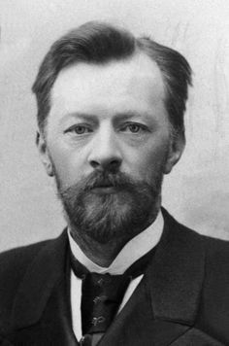
Propp’s Character types
Character Spheres: Propp believes that characters make up the narrative in stories (like in fairy tales).
Hero The most important character. The whole narrative is based around this character
Villain The antagonist. The enemy of the hero
Dispatcher This character makes sure the audience knows who the hero and villain are. And he dispatches .the hero off on his journey/adventure at the start.
Donor Gives the hero what they need, eg magical powers.
Helper This character helps the hero to make progress on his journey so that the narrative continues
Princess/Prize The narrative leads up to the point where the princess is rescued or the hero gets the prize. The narrative cannot continue further until this point has happened.
False hero This character makes the audience believe he is the good guy for most of the narrative, but by the end he either turns to the bad side or reveals that he has been the bad guy all along.
False villain The opposite of false hero. The audience believes that this is a bad guy most of the way through the plot, however, he either turns good or reveals that he has always been a good guy. He then helps the hero achieve the goal.

Slide 10
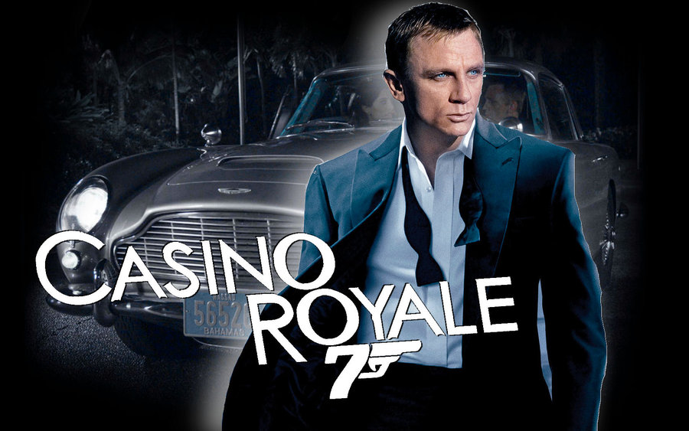
Propp Character types
Casino Royale (2006)
Hero James Bond
Villain Arms Dealers
Dispatcher ‘M’
Donor MI6
Helper Felix Leiter (CIA)
Princess/Prize Vesper
False hero Mathis
False villain Le Chiffre

Slide 11
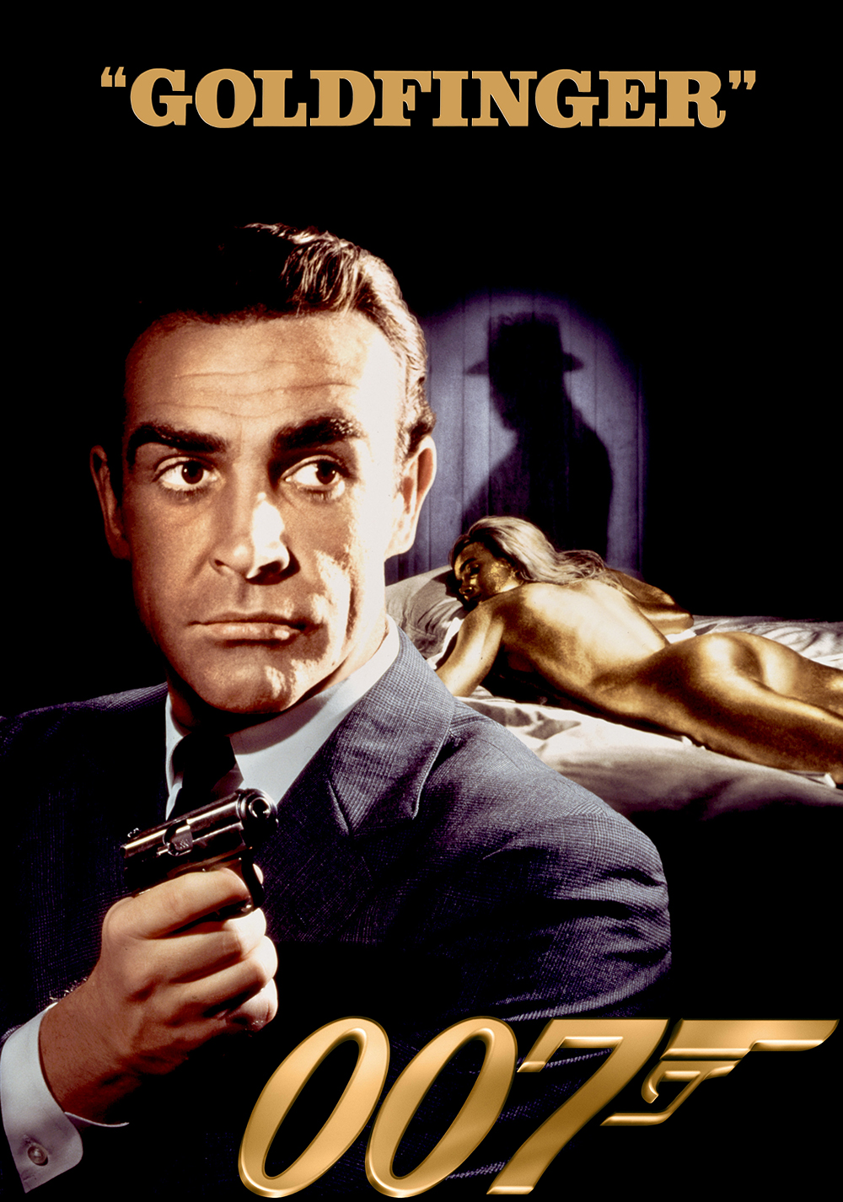
Propp Character types
GoldFinger (1964)
Hero James Bond
Villain Goldfinger
Dispatcher M
Donor Q
Helper Pussy Galore
Princess/Prize Pussy Galore

Slide 12
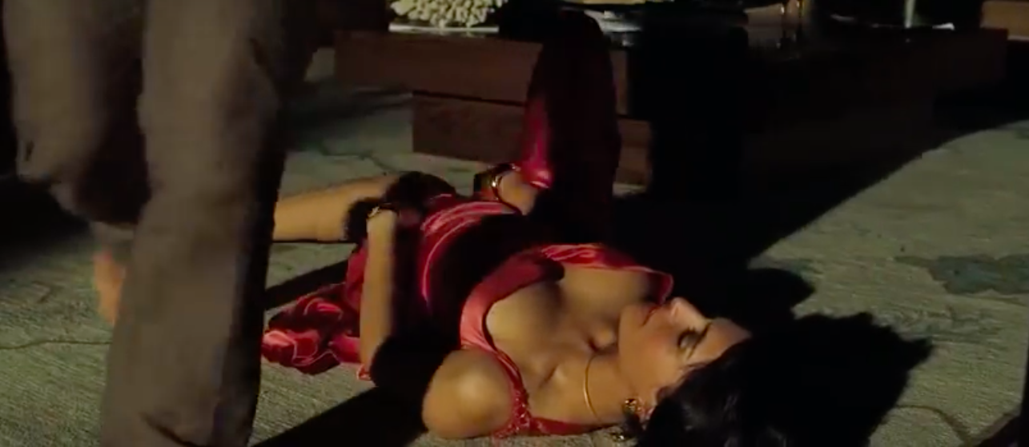
Theories from Mulvey, Todorov and Propp in Action
Casino Royale (2006)
Mulvey
Male gaze theory.
Bond is dressed in this frame and is positioned higher up than the lady on the floor. The camera is angled to show the lady’s beauty and exposed skin.
Lighting is low key to make the room seem more romantic
Todorov
Disruption - Bond uses charm to get the additional information he needs from the extra and quickly gets up to leave
Propp
James Bond - the hero walks away and the with extra who imparts some information could be called a donor.

Slide 13
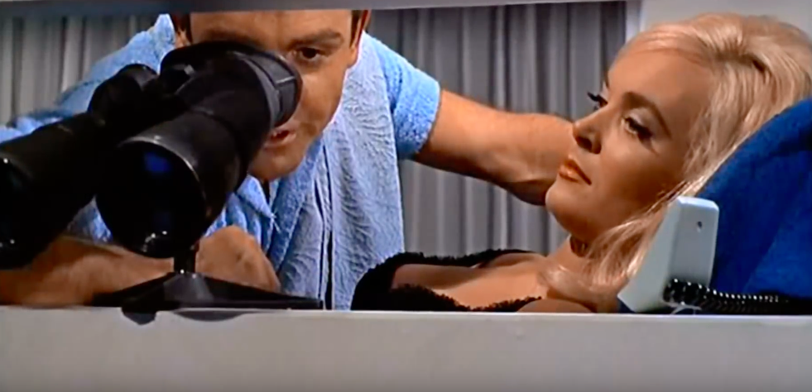
Theories from Mulvey, Todorov and Propp in Action
Goldfinger (1964)
Mulvey.
A good example of the male gaze theory because Bond is in the dominant position in this frame and the extra (as in all typical Bond films) is the underdressed woman with full makeup and her hair styled.
Todorov.
This frame remains as an equilibrium because the real threat has not emerged yet
Propp.
James Bond - The hero with an extra

Slide 14
Bibliography
Thomas B - Narrative : the Basics (Routledge, 2016) ISBN:978-0-415-83264-9
Rose R - Laura Mulvey Visual Pleasure and Narrative Cinema 1975 (Afterall Books, 2016) ISBN 978-1-84638-175-1
https://www.imdb.com/title/tt0058150/
https://www.imdb.com/title/tt0381061/
https://www.youtube.com/watch?v=8kDdIL0tSeI

